Slide 1


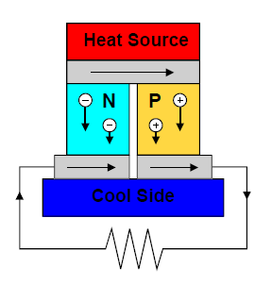
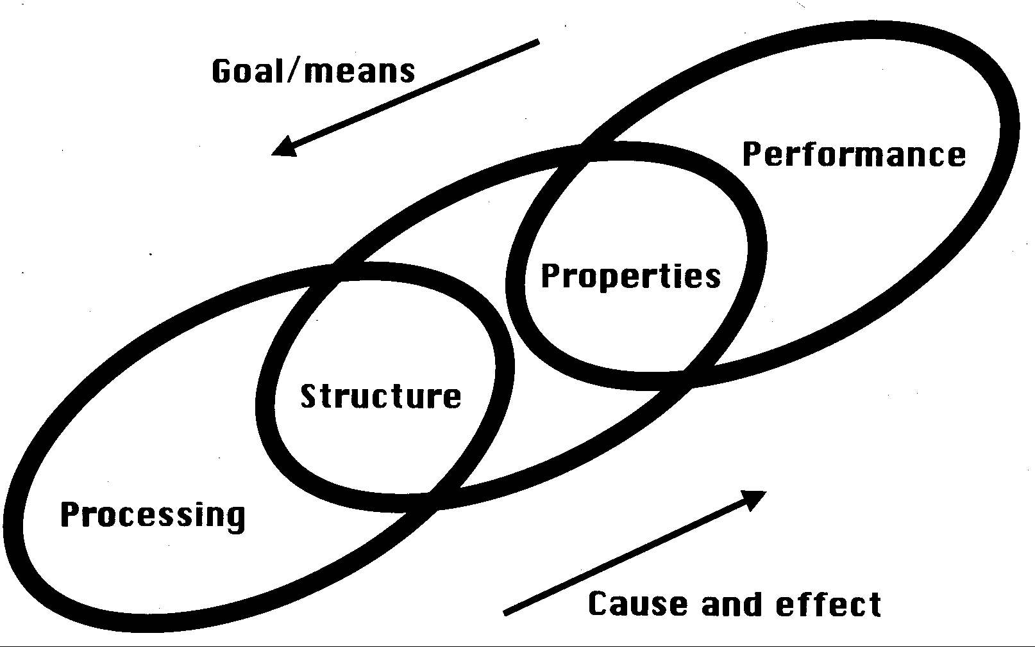
Data-driven Discovery for Designed Thermoelectric Materials
Thermoelectric Use Case Impact
Discovery and design of high-performance thermoelectrics to convert heat to electricity
Target: 50-100% improvement in ZT efficiency over current state-of-the-art materials (ZT < 2.0)
Currently, 60% of power generation lost to waste heat; recapturing a fraction of this using thermoelectrics potentially yields more energy than all renewables combined
Materials Science Domain Impact
Development of powerful computational tools for property-driven discovery and design of new materials
Demonstrate tight integration of theoretical techniques, experimental data, and hierarchical materials design methods to accelerate new materials development
Enable primary goal of Materials Genome Initiative to reduce materials development time from 10-20 years to 5-10 years
Cross-Domain SIMPLEX Impact
Implementation of common framework for multimodal and hierarchical database construction, data analytics, and system optimization/design
Applicable to many complex engineering systems across domains
Notes:
Add verb phrase to connect to MGI (supporting, extending, surpassing, …)
Add a metric for high-performance

